Slide 1
CSS Grid

Slide 2
flex

Slide 3
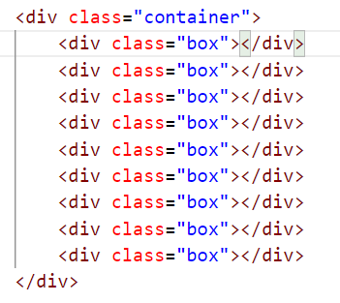
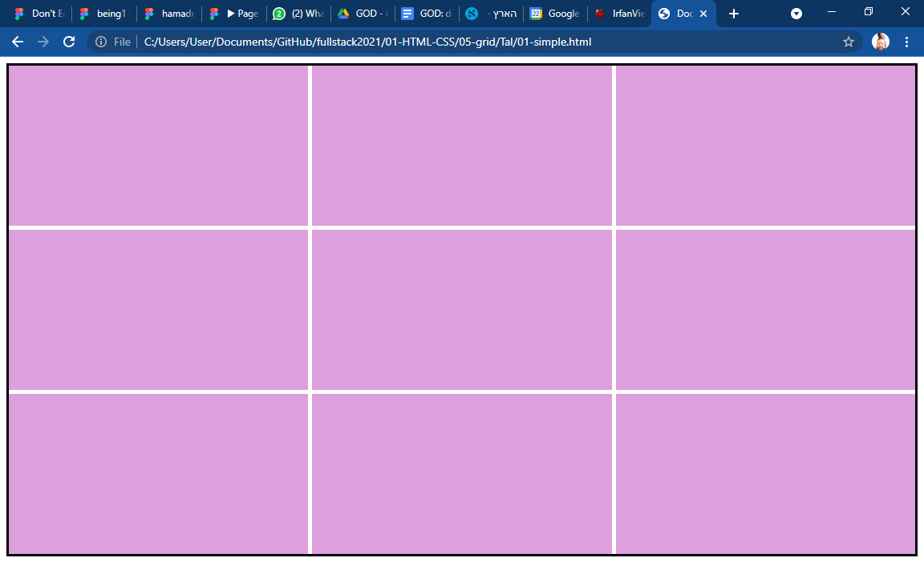
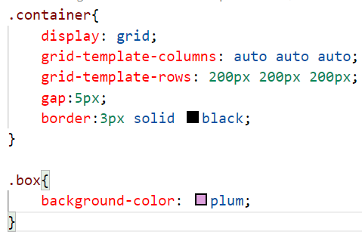
Css grid layout (01-simple.html)

Slide 4
Css grid layout (01-simple.html)
Like in flex, you have to wrap the cells in a container

Slide 5
Css grid Css grid layout (01-simple.html)
Like in flex, you have to wrap the cells in a container
Like in flex, you have to wrap the cells in a container

Slide 6
Css grid layout (01-simple.html)
Grid-template-columns: the number of values set the number of columns. Every value is the width of the column

Slide 7
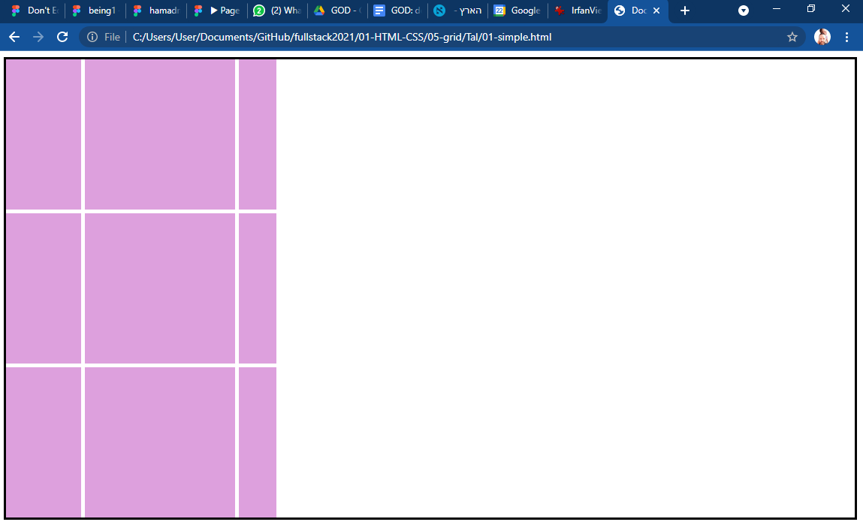
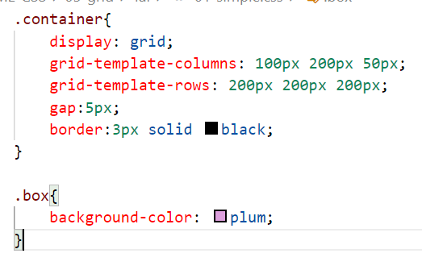
Css grid layout (01-simple.html)
Grid-template-columns: the number of values set the number of columns. Every value is the width of the column

Slide 8
Css grid layout (01-simple.html)
Grid-template-rows: the number of values set the number of rows. Every value is the height of the column

Slide 9
Css grid layout (01-simple.html)
gap: set the size of the gaps between the boxes

Slide 10
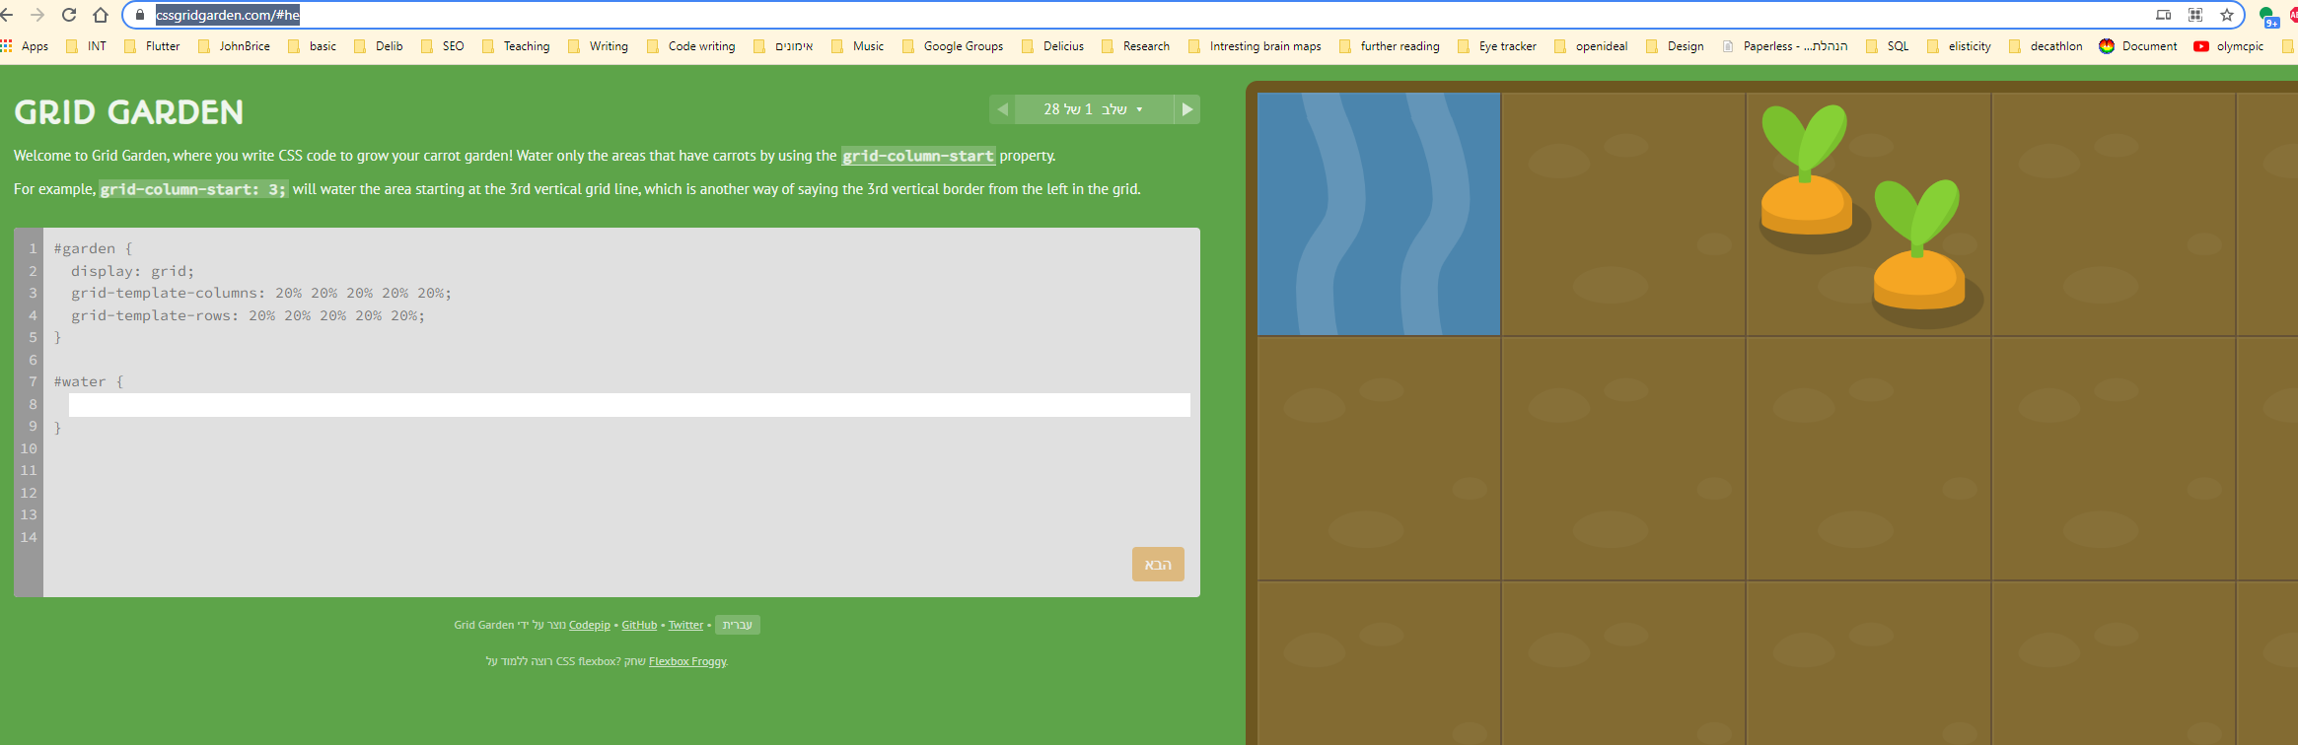
sites
אתר מעולה לתרגול grid (אלכס)

